Slide 1

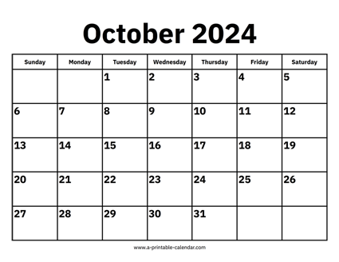

CS 310 : Scalable Software Architectures
Class session on Thursday, October 24th
Notes:
Project 02 due Friday night (or Sunday night late)
Part 01: web service for photoapp, rewrite client
Part 02: deploy to AWS EC2
Gradescope open
Class today?
Review for Tuesday's exam
Exam covers all material through Tues 10/22

Slide 2
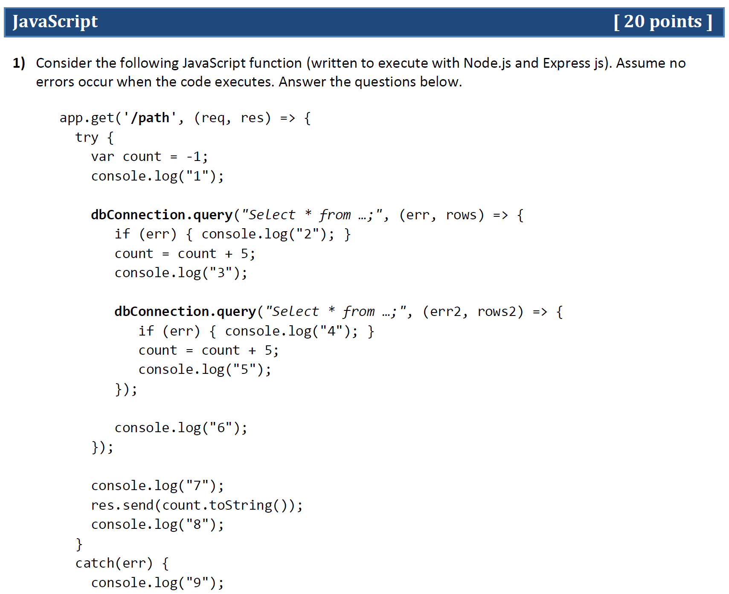
What value is returned to the client?
What output appears on the server console as the function executes?

Slide 3
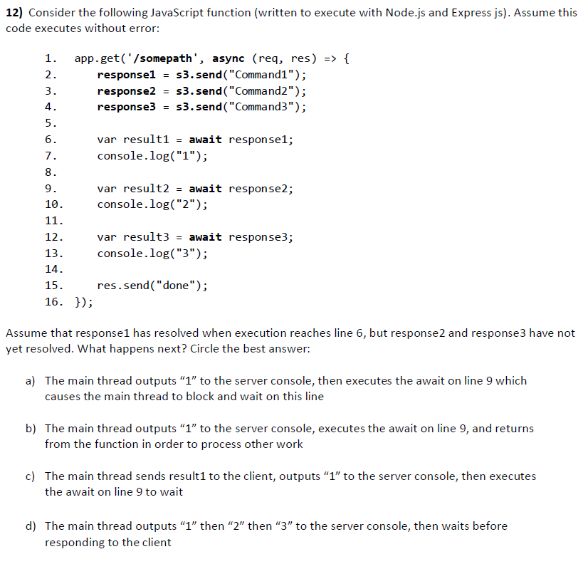
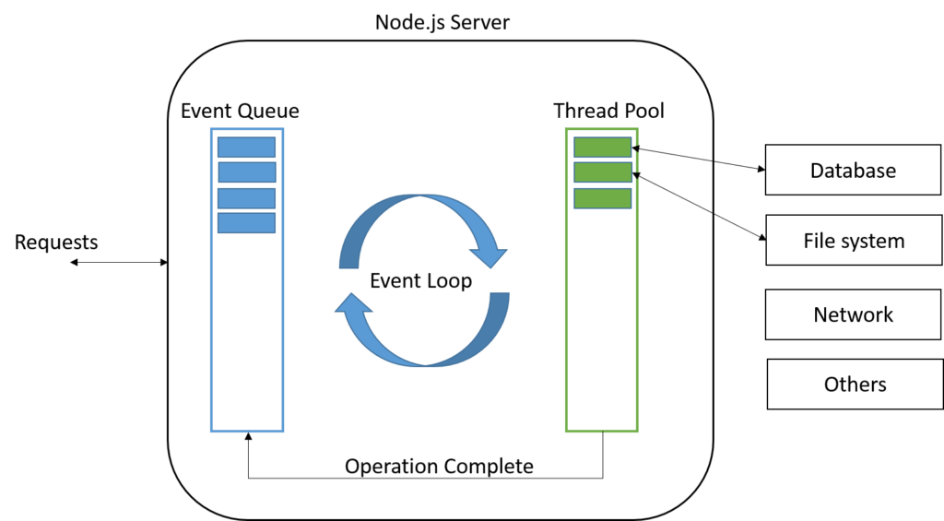
Answer here: https://pollev.com/hummel

Slide 4
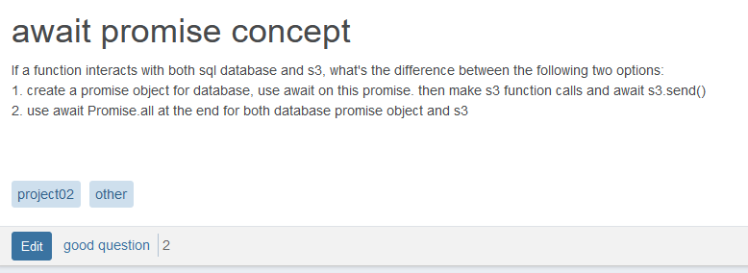
Visualize
Explain 1 vs. 2 by drawing fork-join diagrams…

Slide 5
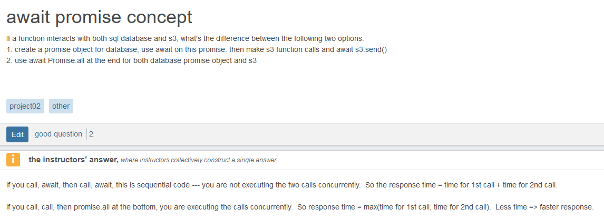






Answer

Slide 6
Design scenario example
We have a scenario with 4 async operations:
Functions A, B, C, and D each return a promise
Respond with "done" when operations have completed
Notes:
Visualize first… Then code the idea at a very high-level…

Slide 7
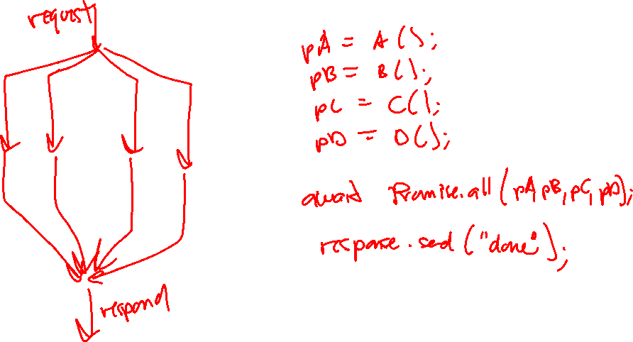
Design scenario example
We have a scenario with 4 async operations:
Functions A, B, C, and D each return a promise
Respond with "done" when operations have completed
Notes:
Visualize first… Then code the idea at a very high-level…

Slide 8
Design scenario #1
We have a scenario with 4 async operations:
Functions A, B, C, and D each return a promise
The results of A and B are input parameters to C
Respond with "done" when operations have completed
Notes:
Visualize first… Idea: fire off A, B, and D. Then create another promise { Promise.all(A, B), get the results, and call C). Now promise.all on D and the new one.

Slide 9
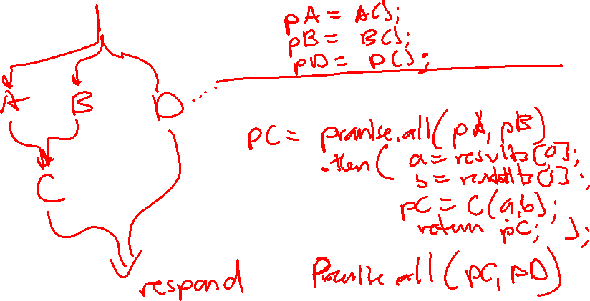
Design scenario #1
We have a scenario with 4 async operations:
Functions A, B, C, and D each return a promise
The results of A and B are input parameters to C
Respond with "done" when operations have completed
Notes:
Visualize first… Idea: fire off A, B, and D. Then create another promise { Promise.all(A, B), get the results, and call C). Now promise.all on D and the new one.
Interesting, keep in mind that Promise.all(pA, pB) does not block and wait, so that's why we want to wrap { Promise.all(pA, pB) => F(results[0], results[1] } in a new promise and Promise.all(pD, pC)

Slide 10
Design scenario #2
We have a scenario with 4 async operations:
Functions A, B and C each return a promise
Function D uses a callback, where the result of B is a parameter to D
Respond with "done" when operations have completed
Notes:
Visualize first… Idea: fire off A, B, and C. Then create pD = new Promise where first you b = await pB, then D(b) => { resolve(result); }. Now promise all on A, C and D.

Slide 11
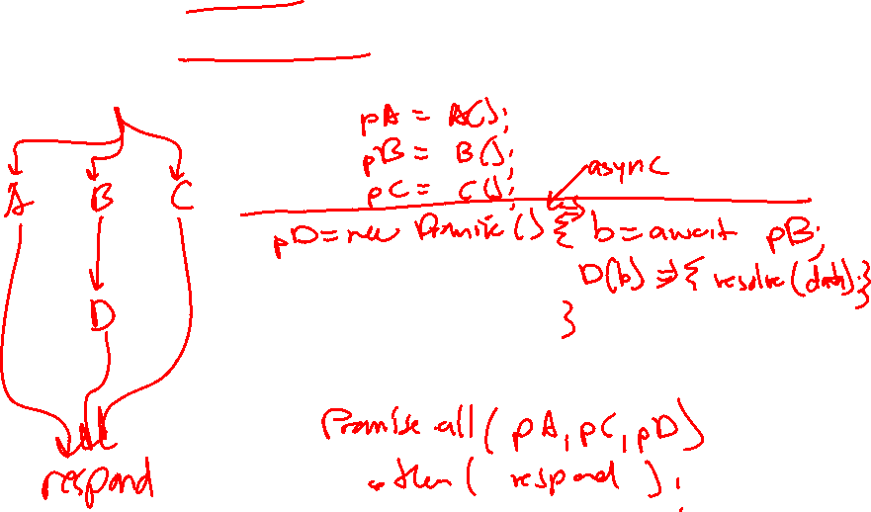
Design scenario #2
We have a scenario with 4 async operations:
Functions A, B and C each return a promise
Function D uses a callback, where the result of B is a parameter to D
Respond with "done" when operations have completed

Slide 12
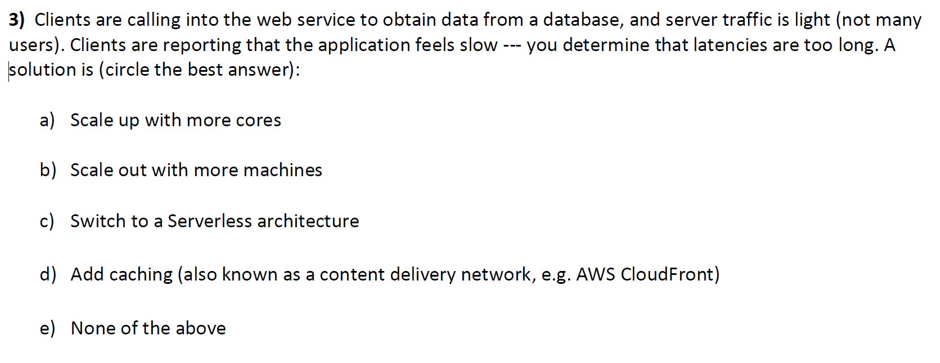
latency
Answer here: https://pollev.com/hummel

Slide 13
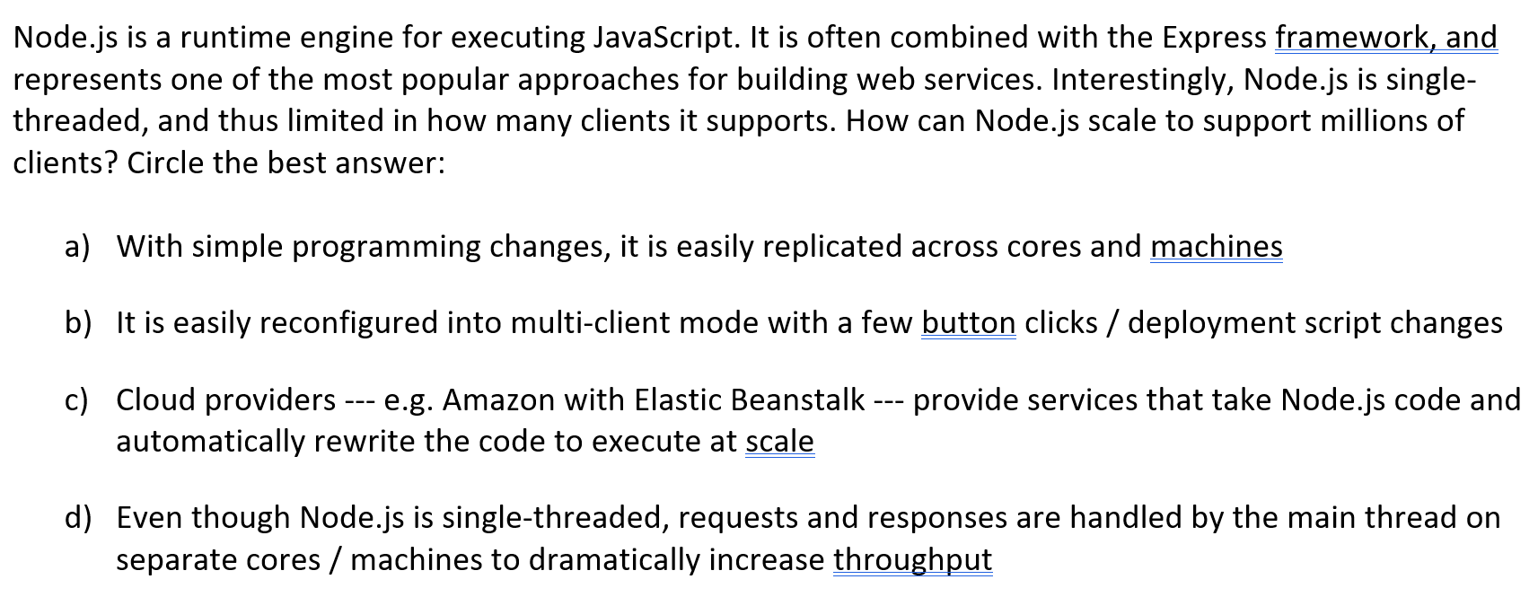
scalability of node.js
Answer here: https://pollev.com/hummel

Slide 14
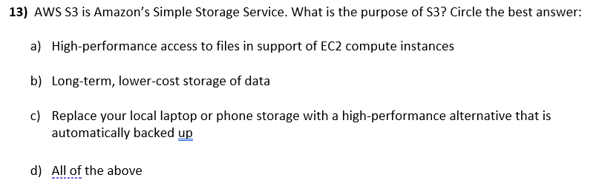
S3
Answer here: https://pollev.com/hummel

Slide 15
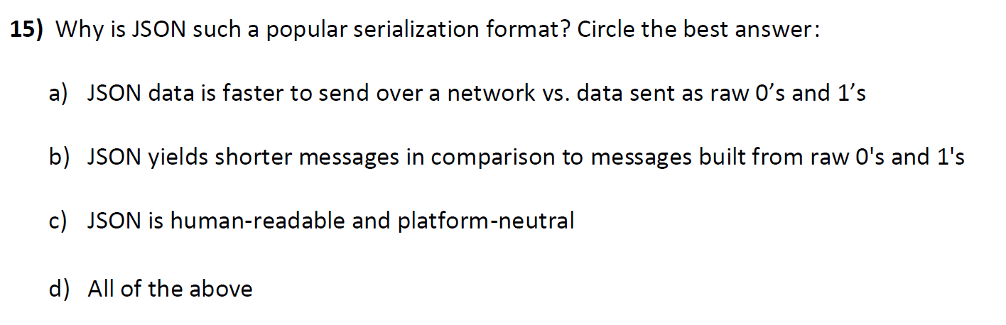
JSON
Answer here: https://pollev.com/hummel

Slide 16
web services
When a client calls a web service function, which network protocol is the client using? Circle the best answer:
HTTP
FTP
SMTP
HTML
Answer here: https://pollev.com/hummel

Slide 17
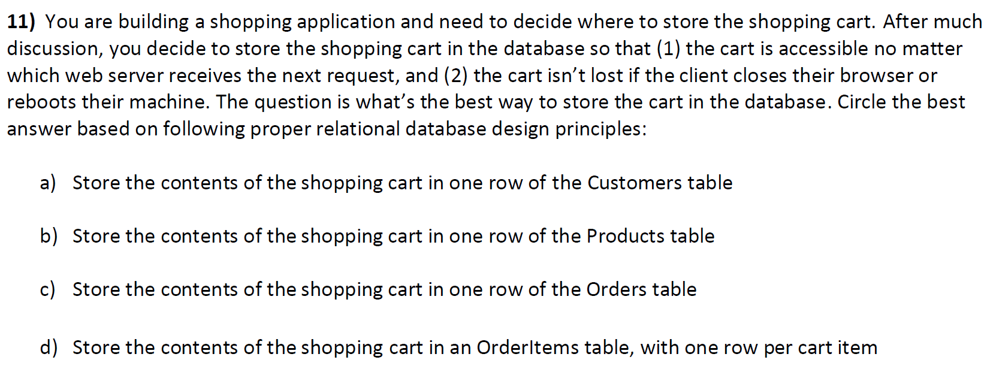
Database design
Answer here: https://pollev.com/hummel

Slide 18
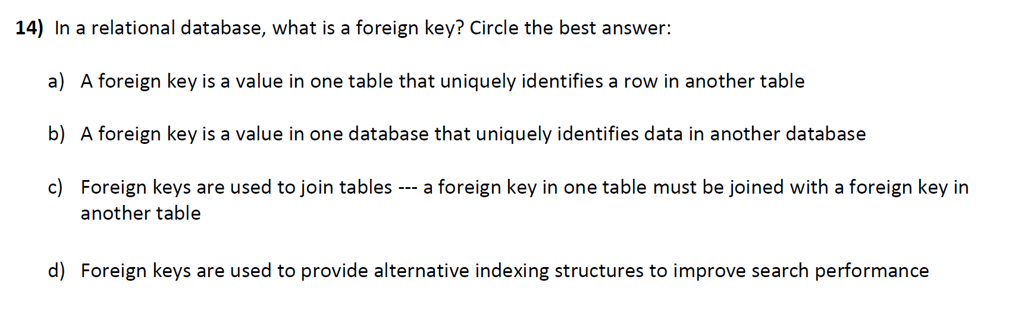
Database design
Answer here: https://pollev.com/hummel

Slide 19
That's it, thank you!

Slide 20
Coding question
There are 4 users and 8 assets in the DB, and 51 items in the bucket. What is the server's response back to the client?
app.get('/sum', (req, res) => {
let numusers = numassets = numbucket = 0;
let numbucket = await s3.send(ListObjectsV2Command);
dbConnection.query("select count(*) as N from users;", (err, rows) => {
numusers = rows[0]["N"];
});
dbConnection.query("select count(*) as N from assets;", (err, rows) => {
numassets = rows[0]["N"];
});
let sum = numusers + numassets + numbucket;
res.json({"sum": sum});
});
A) 0
B) 12
C) 51
D) 63
E) Any of the above
Answer here: https://pollev.com/hummel

Slide 21

async
What does this function output on the console?
assume no errors
app.get('/path', (req, res) => {
try {
console.log("A");
dbConnection.query("Select * from …;", (err, rows) => {
if (err) { console.log("B"); }
console.log("C");
dbConnection.query("Select * from …;", (err2, rows2) => {
if (err) { console.log("D"); }
console.log("E");
}
console.log("F");
});
console.log("G");
res.json("done");
console.log("H");
}
catch(err) {
console.log("I");
res.status(400).json(err.message);
}
});

Slide 22
await
app.get('/somepath', async (req, res) => {
response1 = s3.send("Command1");
response2 = s3.send("Command3");
response3 = s3.send("Command3");
var result1 = await response1;
console.log("1");
var result2 = await response2;
console.log("2");
var result3 = await response3;
console.log("3");
res.send("done");
});
What happens after the main thread reaches the first await?
The main thread continues past the await, outputting "1"
The main thread blocks at the await, and waits
The main thread exits the function and takes the next task from the work queue

Slide 23
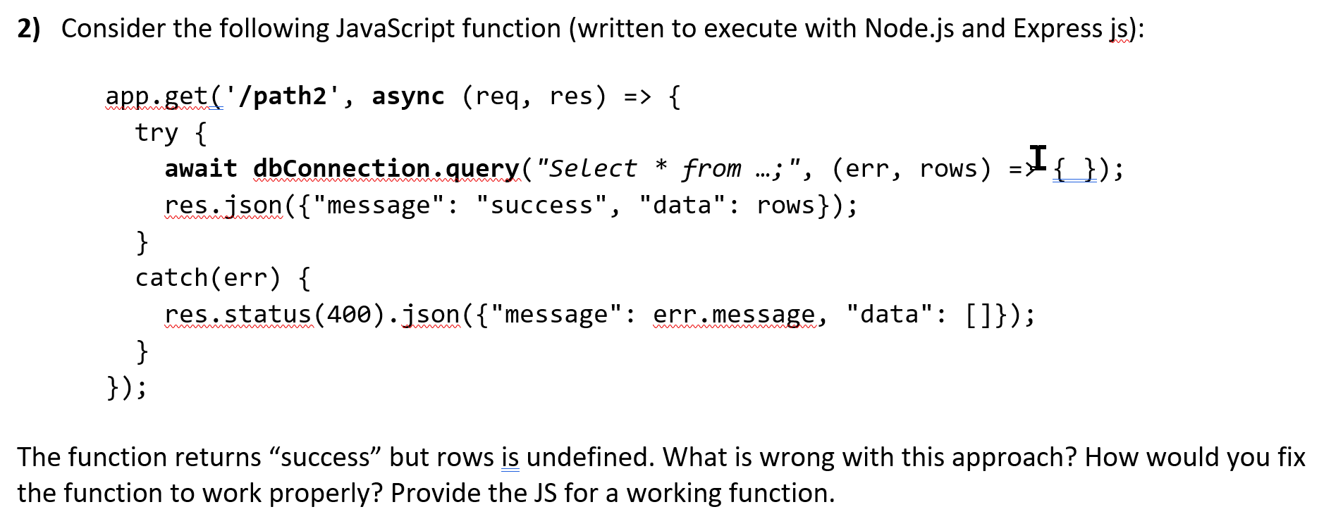
callbacks

Slide 24
Question #6
We want to add a "like" feature to our PhotoApp, which has been extended so that photos can be shared with many users. Which design for our "like" function is the more RESTful?
GET /ilikeimage/:imageid
PUT /like/mostrecent
POST /like/:imageid
https://bit.ly/class-multi

Slide 25
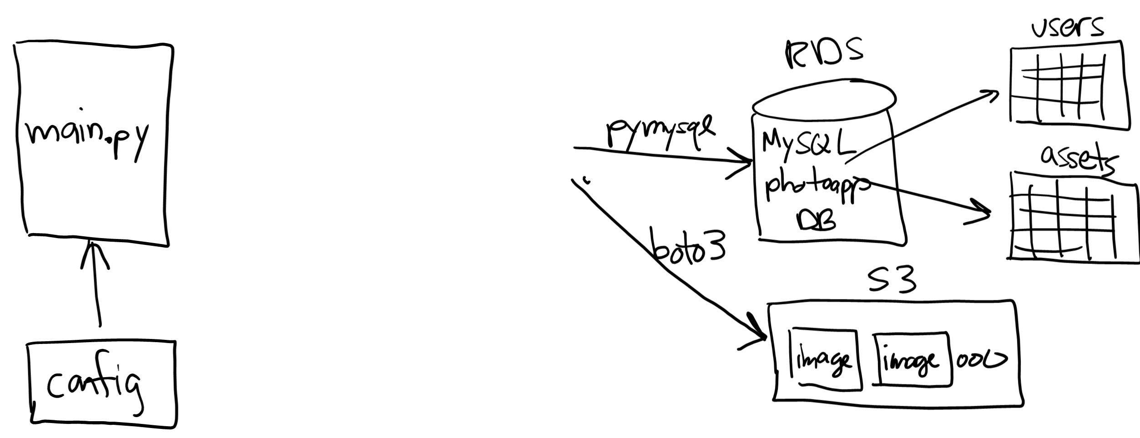

Project 02
Notes:
Demo: connect to "NU guest" and run app --- can I connect to the database? Probably not… Same thing happens in coffee shops. What happened?

Slide 26
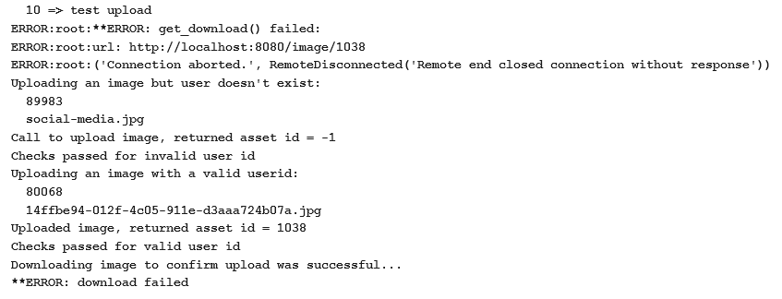
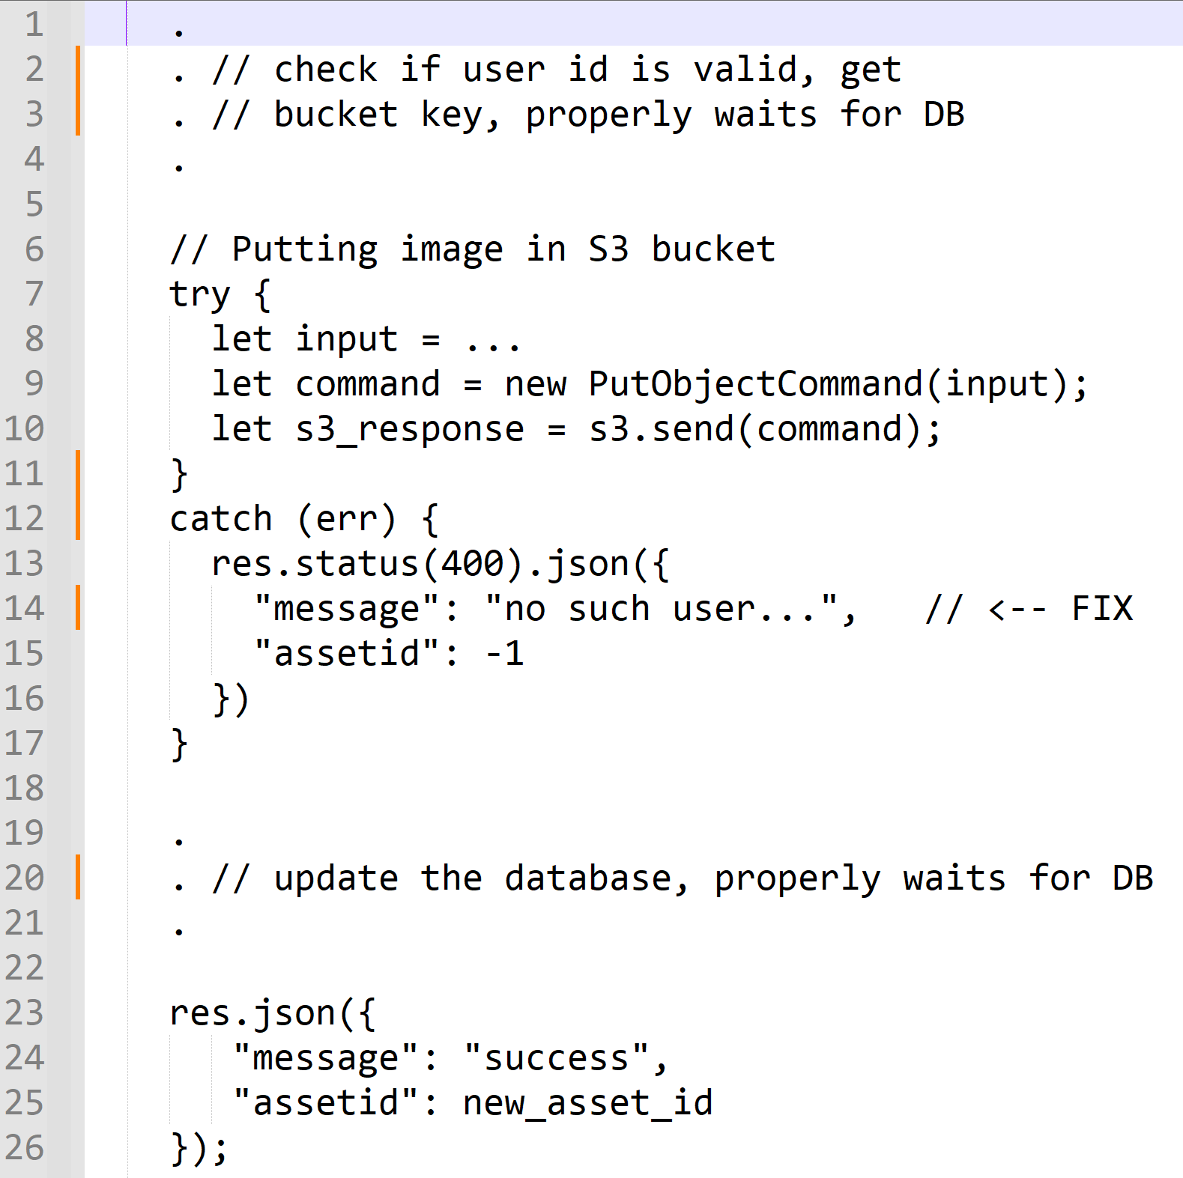

Project 02 – question
Student's code fails server test 6 (image upload). What do you think is the problem with the code?

Slide 27









Answer
Student's code fails server test 6 --- image upload. What do you think is the problem with the code?

Slide 28
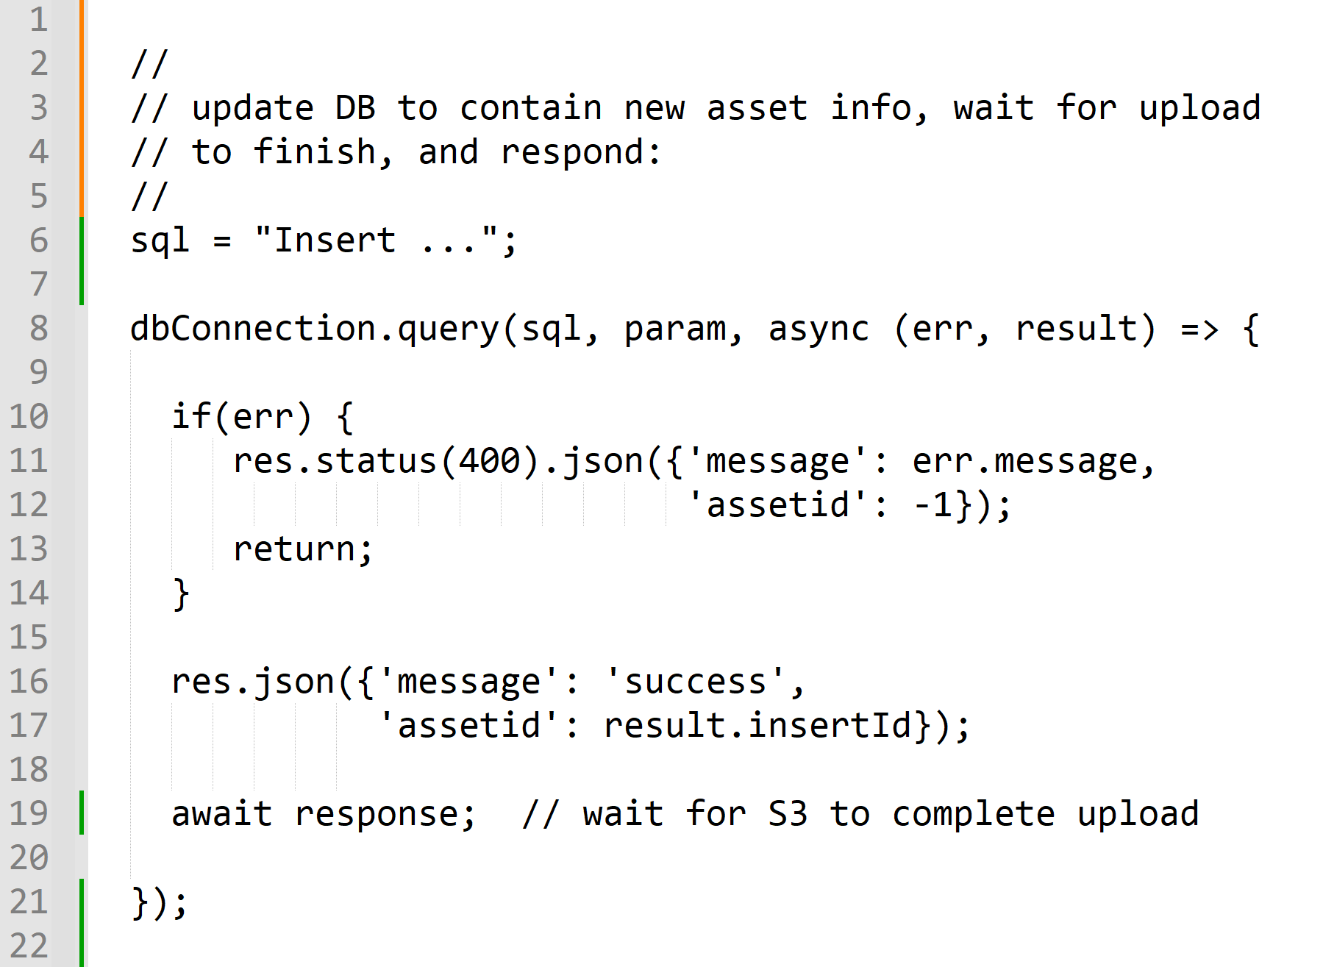
Project 02 – code review
This code is final step of image upload function...
What is this code missing? Any other suggestions?

Slide 29









Project 02 – code review
This code is final step of image upload function...
What is this code missing? Any other suggestions?

